Slide 1
FTAS
Introduction course

Slide 2
Different parts of FTAS
Java
Sikuli 1.1.0
JRuby
Own scripts
Excel
Access database

Slide 3
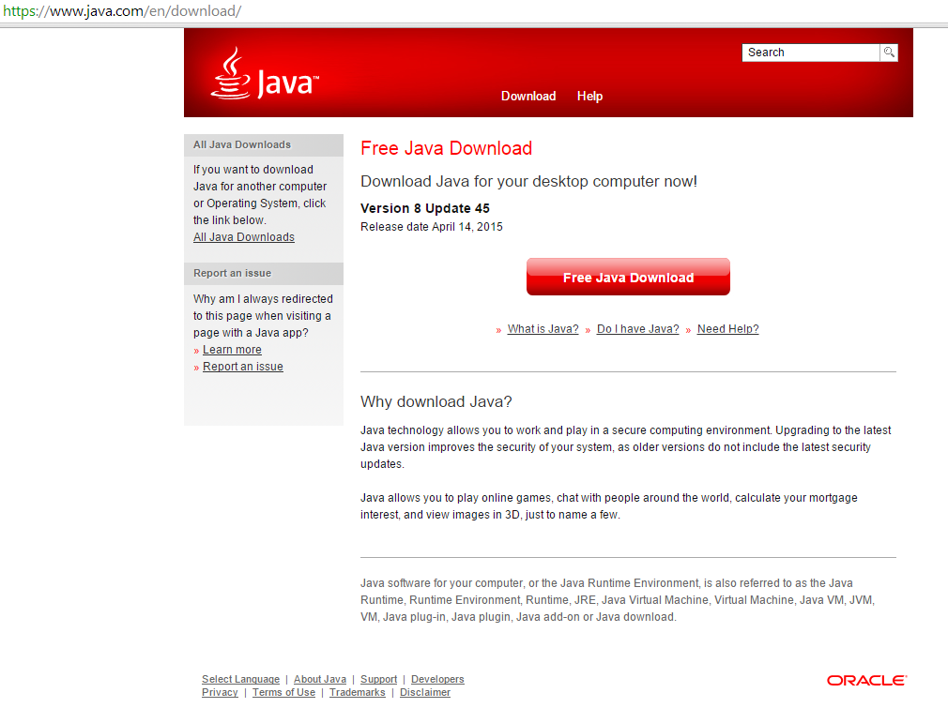
Java

Slide 4
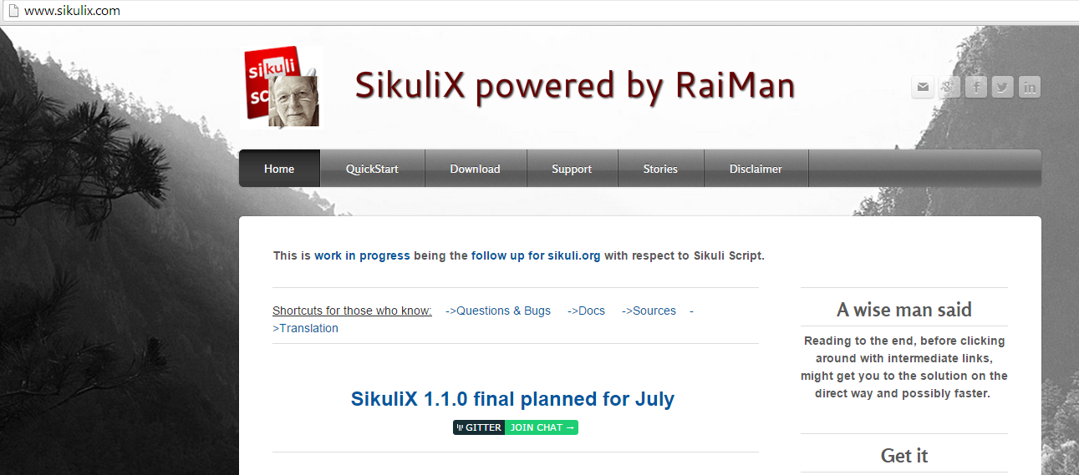
Sikuli 1.1.0
SikuliX.com

Slide 5
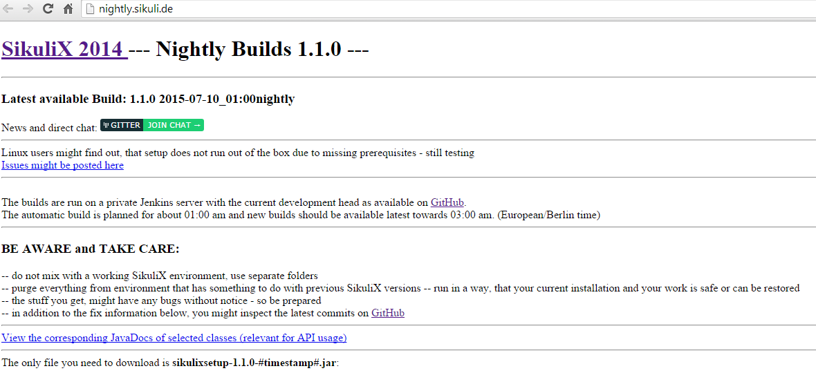
Sikuli 1.1.0 (2)
Download the actual file on:

Slide 6
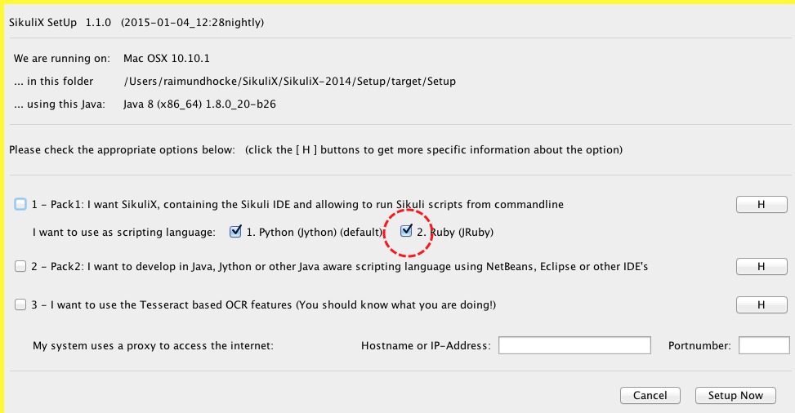
Sikuli 1.1.0 (3)
Use JRuby

Slide 7
FTAS scripts
3 different area’s of scripts.
1: repository
2: project specific
3: generic scripts
4: (configuration… in the future)

Slide 8
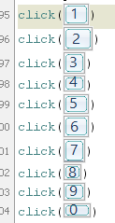
FTAS scripts: repository
All images

Slide 9
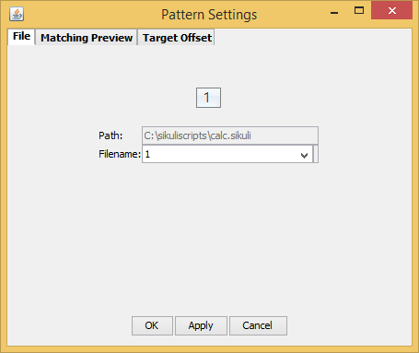
FTAS scripts: repository
Naming of images. Logical names

Slide 10
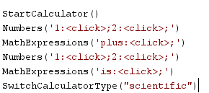
FTAS: project specific
Functions with action names

Slide 11
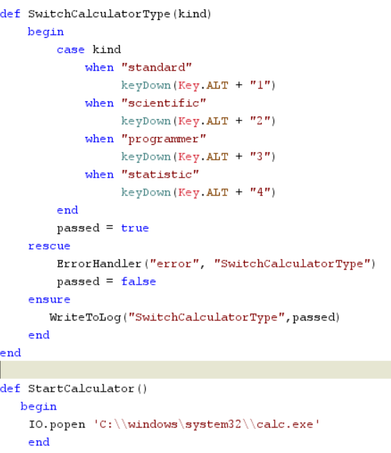
FTAS: project specific

Slide 12
FTAS: project specific
Opening the application with a function
Function that sends keystrokes to change the calculator appearence.

Slide 13
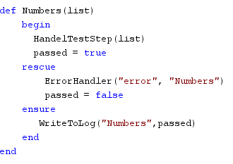
FTAS: project specific
Setup of most functions, handeling objects

Slide 14
FTAS: project specific
Mostly pass the list to the HandelTestStep.
If there is an error, it is handeled in the rescue and ErrorHandler
All steps are written in the log by WriteToLog.

Slide 15
FTAS: project generic
RunTestScript (running a script stored in a file)
HanldleTestScriptFile
HandleTestStep (actionwords and object actions)
HandleActionToObject
ErrorHandler (when error appears, write to log and resume or exit)
ScreenShot (make image of “warning” or “error”)
WriteToLog (write step, warning or error to log)
There is no need to change these function, EXCEPT for the logging. Change path of log.

Slide 16
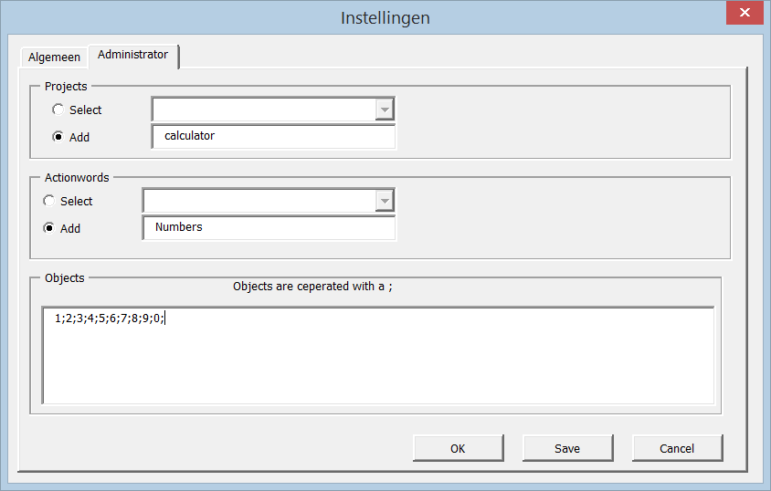
Excel
Adding the project

Slide 17
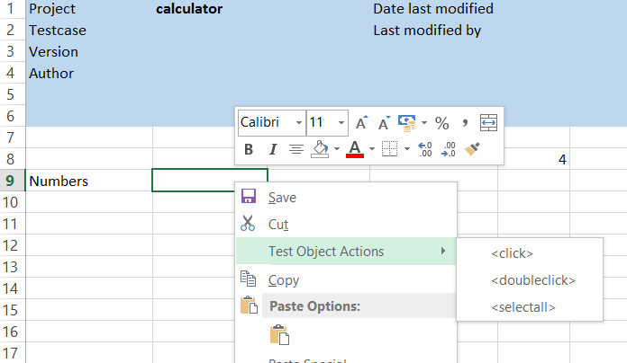
Excel
Filling the script

Slide 18
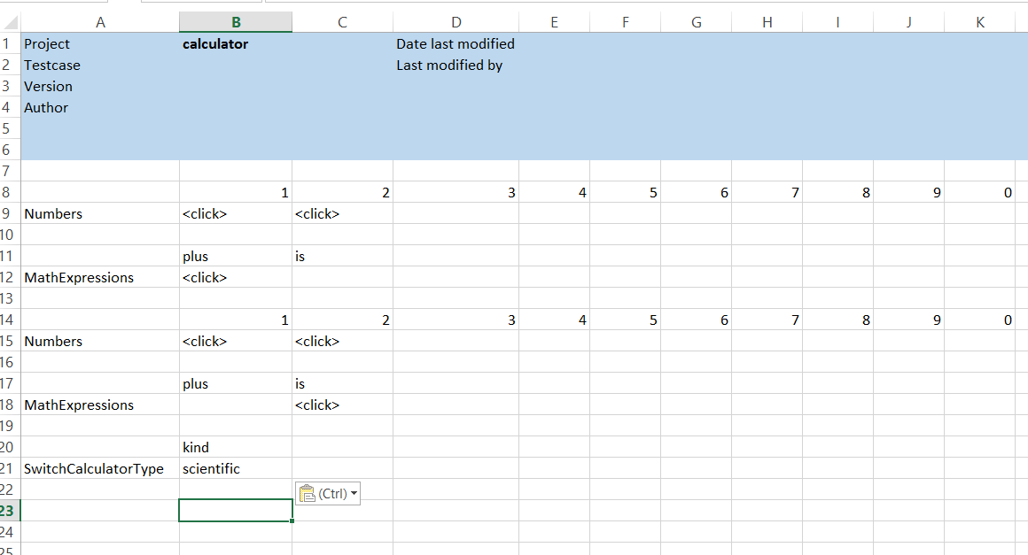
Excel

Slide 19
Excel
Tools to work with
Load projectnames in A2
Load actionwords in A column
Export the script to a textfile
Open configuration screen. Administrator default password “test”

Slide 20
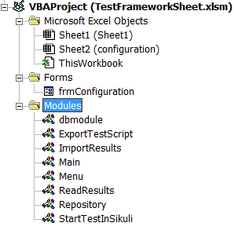
Excel VBA

